Slide 1
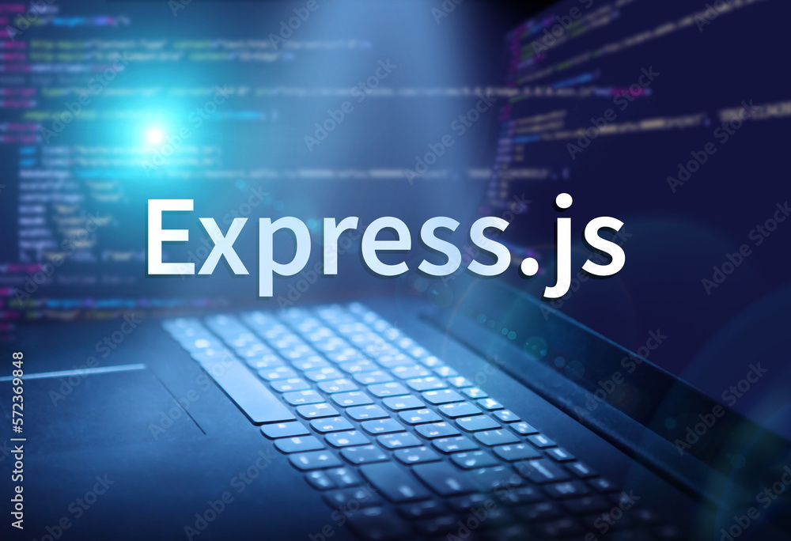

EXPRESS JS

Slide 2
Express JS
Express JS is a frame work for NodeJS. It is a fast, robust and asynchronous in nature/Express is a fast, assertive, essential and moderate web framework of Node JS.

Slide 3
Features of Express JS
It can be used to design single-page, multi-page and hybrid web applications.
It allows to setup middlewares to respond to HTTP Requests.
It defines a routing table which is used to perform different actions based on HTTP method and URL.
It allows to dynamically render HTML Pages based on passing arguments to templates.

Slide 4
Why Use Express JS
Ultra fast I/O
Asynchronous and single threaded
MVC like structure
Robust API makes routing easy

Slide 5
How to Install Express JS
npm install express
Index.js
Var express=require(“express”);
Var app=express();//create instance of express method
app.listen(8000);
app.get(“/”,function(req,res){
res.send(“Index Page”);
});
App.get(“/about”function(req,res){
res.send(“About page”);
});

Slide 6
Express JS Middleware,Postman
App.get(“/about”function(req,res){
console.log(req)
res.send(“About page”);
});
App.get(“/about”function(req,res){
console.log(req.method)
res.send(“About page”);
});
App.get(“/about”function(req,res){
console.log(req.body) Undefind
res.send(“About page”);
});
We want to get the data using body-parser library.

Slide 7
Express JS Example
const express=require('express');
const app=express();
app.get("/",(req,res)=>{
res.send("Home");
});
app.listen(3001,()=>{
console.log("server running");
});
app.get("/contact",(req,res)=>{
res.send("Contact");
});
app.get("*",(req,res)=>{
res.status(404);
res.send("404");
});

Slide 8
File Sysytem in Express JS
const express=require('express');
const path=require('path');
const app=express();
app.get("/",(req,res)=>{
res.status(200).sendFile(path.join(__dirname,"template","index.html"));
});
app.get("/contact",(req,res)=>{
res.status(200).sendFile(path.join(__dirname,"template","contact.html"));
});
app.get("*",(req,res)=>{
res.status(404).send("404");
});
app.listen(3001,()=>{
console.log("server running");
});

Slide 9
Static File Sysytem in Express JS
const express=require('express');
const app=express();
app.use(express.static("template"));
app.get("/",(req,res)=>{
});
app.get("/contact",(req,res)=>{
});
app.get("*",(req,res)=>{
res.status(404).send("404");
});
app.listen(3001,()=>{
console.log("server running");
});

Slide 10
middleware
create a custom middle ware
const express=require('express');
const app=express();
app.use(express.static("template"));
app.get("/home",Token,(req,res)=>{
console.log("user logged in");
res.send("success");
});
function Token(req,res,next){
console.log(req.url);
console.log("token creating");
next();
}
app.listen(3001);

Slide 11
middleware
const express=require('express'); const app=express();
app.use(express.static("template"));
app.get("/home",Token,Validation,(req,res)=>{
console.log("user logged in");
res.send("success");
});
function Token(req,res,next){
// req.user="jinu";console.log(req);
console.log("Createing Token....");
setInterval(()=>{
const TOKEN="123";
req.token=TOKEN;
next();
},4000)}
function Validation(req,res,next){
if(req.token){console.log("token Approved");next();} }
app.listen(3001);

Slide 12
middleware
Remove setinterval and token then give false
After that give true then find the result
Give return in side validation condition

Slide 13


